Slide 1
Supervised Learning Methods
RX 319
Introduction to Healthcare Analytics

Slide 2
Learning Objectives
Describe the goal of supervised learning.
List supervised learning methods.
Describe nearest neighbor analysis.
Interpret a decision tree.
2

Slide 3
Supervised Learning
When you want to use some data to predict something else
Predict if a patient will respond to a treatment
Predict a person’s risk of developing a disease
Predict if a supply will go on backorder
(Some) Methods for supervised learning
Regression
Nearest neighbor analysis
Decision tree learning
Neural networks
3

Slide 4
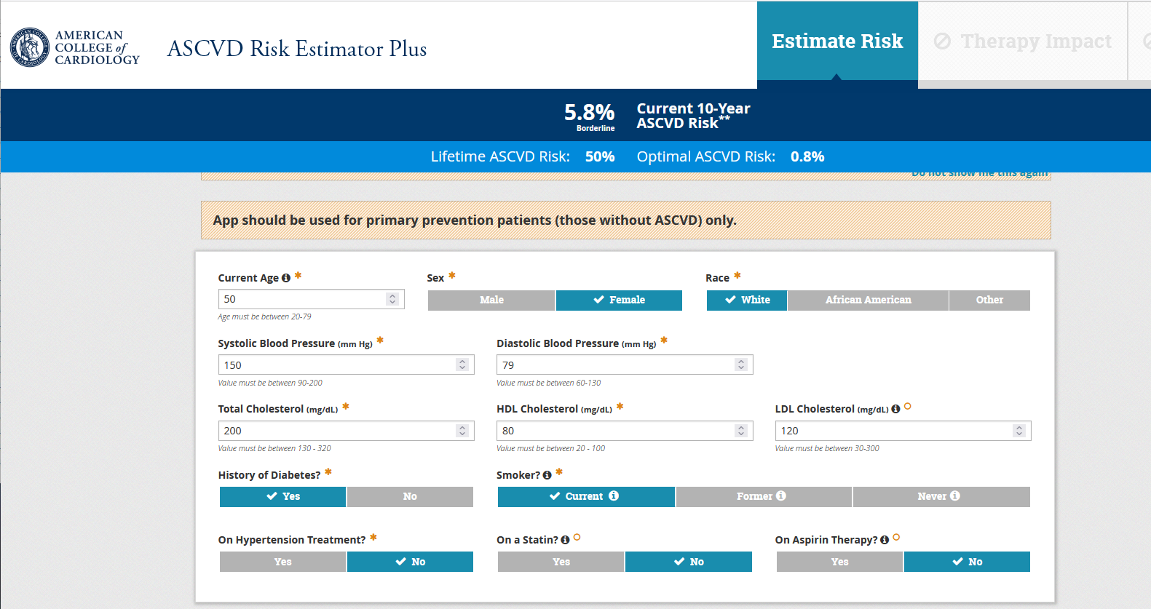
Risk assessment using supervised learning
4
American College of Cardiology Foundation. https://tools.acc.org/ascvd-risk-estimator-plus/#!/calculate/estimate/

Slide 5
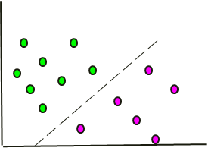
But how?
Lots of patient data
(not this simple)
Feature 2
Total Cholesterol
Feature 1
Age
5

Slide 6
Nearest Neighbor Analysis
Called “k” Nearest Neighbors (kNN), because you select a certain number (k) of nearest neighbors to make your prediction
Example: Predict the mystery dot
k = 5
2 of the 5 nearest neighbors have ASCVD
Total Cholesterol
Therefore, we predict a 40% chance of ASCVD
Simple, but it works! (sometimes)
Age
6

Slide 7
Decision Trees
Decision trees identify rules to best split the data
Age < 50 ?
Age = 50
yes
no
Predict Healthy
TC < 235 ?
Total Cholesterol
TC = 235
yes
no
Predict Healthy
Predict ASCVD
Age
In R: rpart package
7

